Slide 1

Multi-task Learning for Dense Prediction Tasks in Computer Vision
Arun Talkad

Slide 2
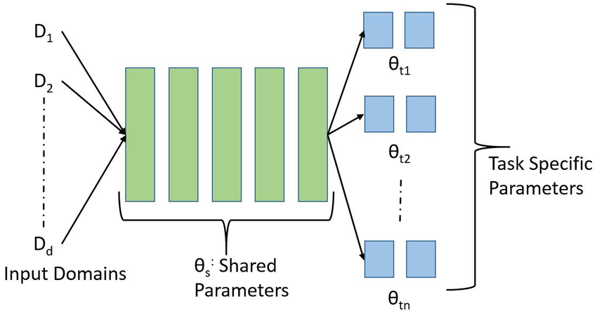
What is MLT?
Multi-Task Learning(MLT) is a family of techniques that are designed to learn multiple tasks at the same time
MLT relies on identifying a common representation from different datasets that can solve multiple tasks at different layers of abstraction
Task specific layers are then applied on the data to ensure that the model can solve multiple tasks at the same time

Slide 3
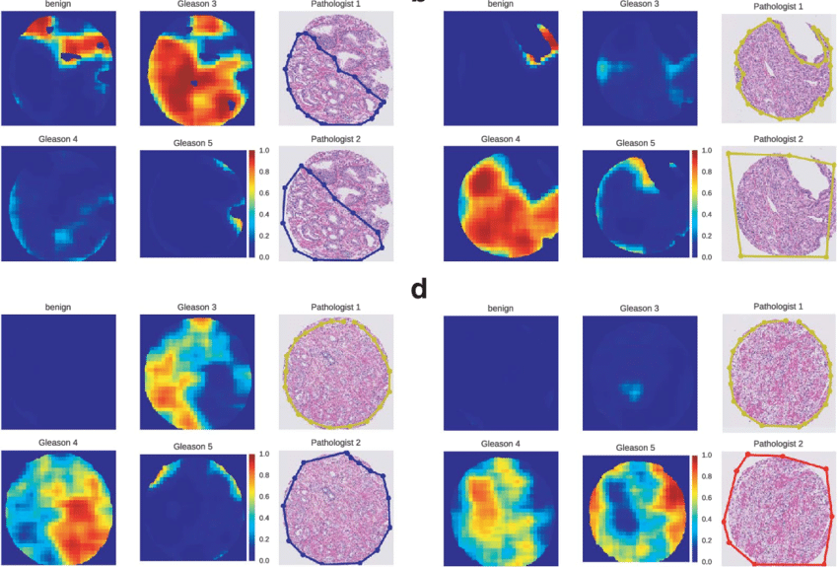
Dense Prediction and MLT
Dense Prediction refers to predicting different outputs at a pixel level, thereby producing a ‘dense’ output.
Example – Model identifies Gleason pattern which indicates abnormalities at a pixel level
MLT allows for such costly operations to be performed at a much more cost-effective scale by learning a common representation and building over with task specific layers

Slide 4
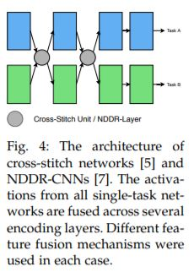
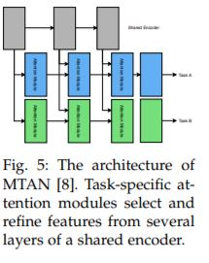
Encoder-focused Architectures

Slide 5
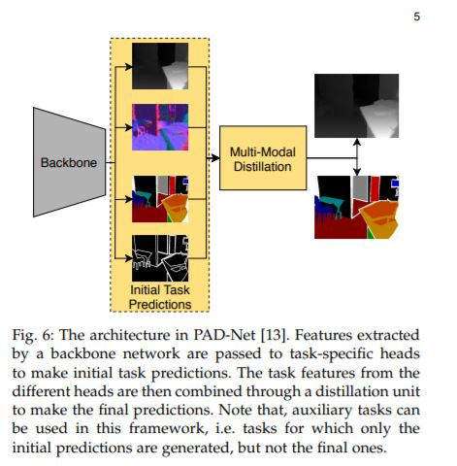
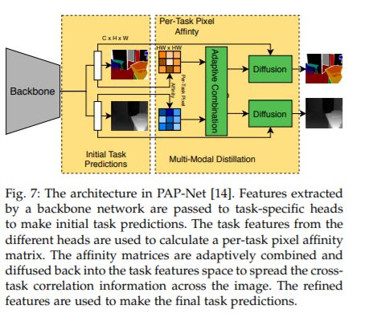
Decoder-focused Architectures

Slide 6
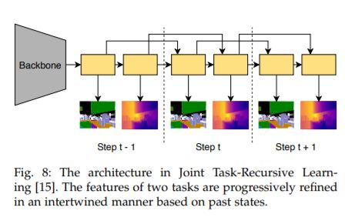
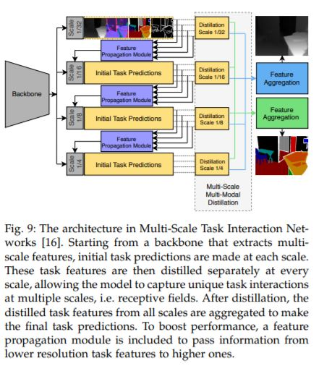

Slide 7
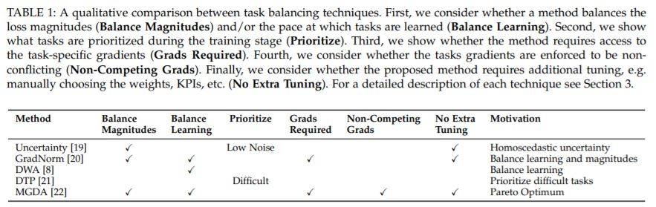
Optimization Techniques

Slide 8
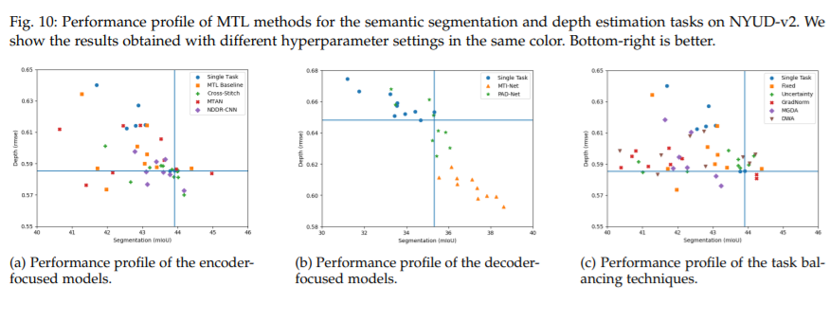
Results

Slide 9

Thank You!

Slide 10
References
[1] An All-In-One Convolutional Neural Network for Face Analysis - Scientific Figure on ResearchGate. Available from: https://www.researchgate.net/figure/A-general-multitask-learning-framework-for-deep-CNN-architecture-The-lower-layers-are_fig1_309663347 [accessed 28 Nov, 2021]
[2] Vandenhende, S., Georgoulis, S., Van Gansbeke, W., Proesmans, M., Dai, D., & Gool, L.V. (2021). Multi-Task Learning for Dense Prediction Tasks: A Survey. IEEE transactions on pattern analysis and machine intelligence, PP.

